Slide 1
Lecture 1 Introduction
Computing platforms
Novosibirsk State University University of Hertfordshire
D. Irtegov, A.Shafarenko
2018

Slide 2
What is a [computing] platform?

Slide 3
So, what we mean by Platform
Platform is something you can use to build something else
In this course, we somewhat extend this concept
We call a Platform something you can use
So we can group application and system components into a single category
In computing, many platforms are actually virtual machines built on top of another platform
But you cannot build a purely virtual machine
There must be something real at the bottom

Slide 4
Computer languages
Digital computers are language machines
You write a program in some language
Computer runs (executes) it
Every platform has a language (some have many)
Build something on a platform ~= write a program using a platform language
But platform is not A language,
It is an environment (virtual machine) to run programs in a specific language
And often a toolset to aid in creating programs (debuggers, profilers, IDE, etc)

Slide 5
Platforms hierarchy

Slide 6
It is even more complex
Modern technology allows us to build anything from anything
Application-level platform can have it’s own programming language (“scripting language”), and people can use it to build something of even higher level
Example: Web browsers and JavaScript
You can use high-level platforms to emulate lower-level ones
Example: Virtual machines in narrow sense (hypervisors, like VirtualBox or VMWare)
You can write a program in JS, emulating a hardware CPU capable of booting Linux or Unix (try to calculate a platform level of C program running on this system) and because of optimizing JiT it can have a decent performance
We won’t discuss it now, let’s deal with simple case first

Slide 7
Why so many levels?
Short answer:
Modern computer systems are very complex
Hierarchy is one of best ways to deal with complexity
Another short answer
You can simplify programming (=> write more complex programs) by making computer to help you write programs
Then it got out of control
Long answer:
Probably you will understand it as you learn several platforms of different levels

Slide 8
What is virtual machine
In this course, virtual machine is a platform that is different from lower level platform
Other textbooks and documents can use different definitions
Usually, higher level platform is easier to program
So, most programming is done in Level 4 and higher
Other reasons to create virtual machines:
To run programs from old or different platforms
To run several platforms on single physical machine
To aid in testing and debugging
Etc

Slide 9
Why study low level platforms?
Virtual machines are not perfect
VM tries to isolate you from details of lower-level platform, but it is impossible
Specifics of low-level platforms (resource limitations, performance bottlenecks, logical constraints, etc) leak to higher levels
If you know low-level platforms, you will understand higher-level ones (like C language or operating systems) much better.

Slide 10
Language translation
Create VM ~= create a mechanism to translate platform language to the lower-level platform
Two main techniques:
Compilation
You take source program and generate a new (supposedly equivalent) program in target language
Interpretation
You take source program and interpret is statement by statement
Lowest level language must be interpreted, because (by definition) there is no lower-level native language
There are hybrid techniques, like JiT compilation
But we won’t discuss them now

Slide 11
Advantages of compilation
Compiled program is not different from native language program. Actually, it IS a native program
It means, there is no runtime overhead
compiled program can be suboptimal, this can be seen as form of the overhead
Modern compilers are very good at writing optimal programs, on average, better than humans

Slide 12
Advantages of interpretation
Interpreter is often simpler than a compiler
You can do runtime checks (implement a “sandbox”) and run untrusted programs
Handling runtime errors is much simpler
Development and debugging cycle can be faster (no compilation phase)

Slide 13
Software and hardware
Software and hardware are equivalent
With the exception that pure software cannot run (it must have some hardware below)
To run software, hardware must be programmable
Any specific function can be implemented both in hardware and in software
In this course we will learn how to implement some interesting functions in hardware
I hope this will give you the idea how to implement even more complex functions, essentially everything you can imagine
There are tools to describe hardware designs in high-level languages, similar to high-level programming languages, and automatically build circuits based on these descriptions (silicon compilation)
Most modern hardware is designed by tools like that

Slide 14
Reasons to choose
Reasons to choose between hard- and software are mostly economical
Hardware is usually faster, but this is not always important
Software is cheaper to develop, copy and modify
Complex designs practically always have bugs
You cannot use them if you cannot modify (fix) them
Multilevel organization allows you to move between hard- and software implementations without breaking higher-level platforms

Slide 15
Von Neumann computer
A programmable computing platform with random access program memory
Typical example of Level 2 platform
Usually an interpreter
there were attempts to implement so called binary compilation, but they failed and there are reasons for that
One of most widely used types of programmable hardware
We will briefly discuss some other types of programmable hardware in next semester
Anything called a ”computer” has [at least one] von Neumann CPU inside
Many pieces of modern hardware you do not call a “computer” also have von Neumann CPU[s] inside

Slide 16
More on von Neumann computers
Von Neumann computer interprets values in memory as commands (instructions)
Values in memory are numbers
In binary computers, they can be viewed as bit strings (thus the term “binary code”)
But some von Neuman computers were not binary
For example, ENIAC was decimal

Slide 17
CPU commands
Every valid command has a number (opcode)
List of all valid commands (together with description of their semantics) is known as ISA (Instruction Set Architecture) or machine language
ISA is not to be confused with assembly language, which is Level 3 platform in our classification
Program in machine language is a sequence of numeric (binary) commands, known as binary code
Assembly language program is a human-readable representation of machine language program

Slide 18
Why random access is important
When program is loaded in random access memory, every command has an address (a number of memory cell where this command is located)
Von Neumann CPU has so called jump (branch) instructions that transfer execution to any specific address
So, the execution of program is not [strictly] sequential
Jump instructions are used to implement constructs like loops, conditional statements, subroutine calls, etc
Most of this semester is dedicated to studying how this actually works

Slide 19
CPU families
People want to run programs for old CPUs on newer machines
Series of CPU with the same or compatible ISA
Compatible means that never versions of ISA have all the same commands as older one, may be with addition of some new commands.
Oldest widely used ISA is IBM System/360, first developed in 1965.
Still fully supported by IBM System/z computers
Probably second oldest (between widely used now) is MCS-48 family of 8-bit microcontrollers, developed by Intel in 1976 and licensed by other manufacturers.
Every PC-compatible motherboard has MCS-48 circuit, typically implemented as part of so-called ”south bridge”

Slide 20
Popular ISA: ARM and x86
x86 - CPU family compatible with Intel 80386, released in 1987.
Older Intel CPU like 8086/88 and 80286 are NOT members of x86 family
Originally 32-bit, extended to 64-bit (x86_64 or simply x64) by AMD in 2003
ARM (originally Acorn RISC Machine) was developed by Acorn Computers in 1985 for use in Acorn Archimedes microcomputer.
In 1990s it was licensed by other manufacturers mostly for embedded applications
In 2000s it started to gain popularity in smartphones, and circa 2010 it surpassed x86 by worldwide usage
Originally 32-bit, extended to 64-bit in 2011.

Slide 21
Why not study commercial ISA?
Well, nobody forbids you to study ARM or x86 or MCS-48/51 or Atmel AVR or etc
On interview, I’ve heard some of you actually studied Arduino
But commercial ISA have long (and sometimes tragic) history and are constrained by backward compatibility
Many important details and even concepts of x86 or ARM cannot be understood without knowing peculiarities of 1980s hardware and intellectual fashion of that period
x86 is also constrained by attempts to maintain assembly-level and OS-level compatibility with 80286, 8086 and even earlier 8080/85 ISA
This will distract us from basic concepts we need to understand

Slide 22
Welcome CdM-8
CdM-8 is a 8-bit Level 2 platform (von Neumann CPU) designed by A. Shafarenko
Two implementations:
Software emulator cocoemu, written in Python
Works together with CocoIDE
Gate-level (Level 1) circuit file for Logisim
No silicon and copper hardware implementation (somebody want to volunteer?)

Slide 23
Why CdM-8 (an analogy)
Modern aircrafts are pretty complex

Slide 24
So let’s start from something simpler

Slide 25
Why it is good idea
It can fly
It is fun to fly
It can be disassembled to sticks and gadgets and assembled back (and it is also fun)
It can illustrate basic concepts like lift and drag
It can illustrate some not so basic concepts like stability, weight discipline and stall recovery
As you understand basics, we can move to something more complex

Slide 26
Advantages of CdM-8
Very simple design, good for illustrating both Level 2/3 and Level 0/1 concepts
No backward compatibility burden and related complexity
Fully functional (for a CPU with 256 bytes of total memory)
Advanced macroassembler with some capabilities of Level 4 platforms (thus the name Level 3 ½)
Nice IDE with ability to see all program and data memory in a single window (impossible even on 16-bit CPU!)
Extended version with interrupts, memory banks and system/user mode
Ability to extend the design with Logisim circuits

Slide 27
Two types of von Neumann CPU
Manchester architecture (for “Manchester Baby”)
Stores program and data in same memory
In some textbooks, only Manchester computers are called von Neumann computers
Harvard architecture (for Harvard Mark I, which was not even stored-memory computer)
Uses separate banks of memory for program and data
If you remember, ENIAC was actually a Harvard computer
Some CPUs can be switched from Harvard to Manchester by single fuse or just by reconnecting memory banks
Some textbooks and documents use other definitions
For example, some CPUs use separate caches for code and data, and this is called Harvard architecture even if these caches are backed by same main memory

Slide 28
Course materials
http://fit.nsu.ru/~fat/Platforms
Short documentation on CdM-8 ISA and long book, containing full description of CdM-8 platform and toolchain and other useful and interesting info.
To run CdM-8 tools (cocoide, cocas, cocoemu), you need Python 2 (2.6 or 2.7 recommended). Cocoide depends on tkinter library (installed by default on Windows and MacOS)
For your convenience, Logisim archive is included. You also can download it from official site http://www.cburch.com/logisim/ , it is free.

Slide 29
How we will work
Your main teaching guide is Cocomaro the Robot.
It is a mail robot which will send you emails
Every email will contain a task description and instructions how to submit a solution
After your send a correct solution for a task, Cocomaro will send you next one
Cocomaro checks for new mail every three minutes 24/7 (if it does not, you should alert me)
If you have questions, you are free to ask me and other teachers, personally during practice lessons or by email

Slide 30
Course grading
Tasks sent by Cocomaro will not be graded, so cheating is pointless
We will have assessment tests on most of practical lessons
Assessments will include questions and solving tasks similar to ones that were sent by Cocomaro
You will solve tasks in controlled environment, with cheating prohibited

Slide 31
Course grading
First semester is graded fail/pass
To pass, you must successfully complete ~25% of all tests (I hope this will be simple)
Second semester is graded 2/3/4/5
You do a group project
Groups are formed semi-randomly, so every team will have students of different level (based on assessment tests)
Group project results are main component of the final grade
If you are not happy with project results, you can try to get a higher grade by passing the exam

Slide 32
Some interesting facts
One of the first working von Neumann computers was created programmatically
Originally it was the first fully-electronic computer called ENIAC
Design started in 1943, delivered in 1945
Used for military research, including numerical modelling of thermonuclear explosives
It was programmed by so called plugboards

Slide 33
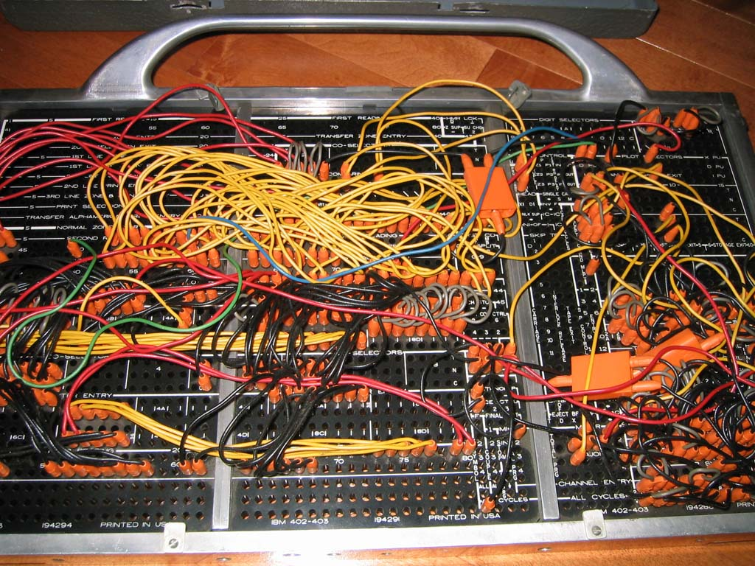
Plugboards
Also known as patch panels
Used in 1930s to “program” IBM tabulators (machines for processing punch cards)
Image CC BY 2.5, https://commons.wikimedia.org/w/index.php?curid=522789

Slide 34
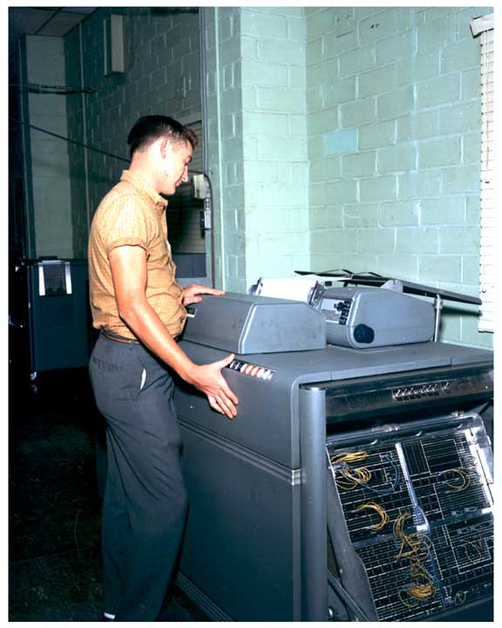
Plugboards and tabulators
An IBM 407 Accounting Machine with control panel (plugboard) inserted, but not engaged.

Slide 35
ENIAC
On the left:
Arithmetical units with plugboards
On the right:
Function tables (sort of read-only
random-access
memory, every cell is a mechanical
10-position switch)

Slide 36
ENIAC as von Neumann CPU
In 1948, ENIAC was converted to a stored-program computer by creating a ”program” (plugboard wiring) to use function tables as program memory
Von Neumann was not inventor of this idea, but he worked as a consultant in EDVAC project and participated in ENIAC conversion
EDVAC was operational in 1949 and was not a true von Neumann machine
EDVAC used serial (not random access) program memory based on mercury delay lines

Slide 37
First true von Neumann computer
“Manchester baby” or SSEM
Created in Victoria University of Manchester, England
Von Neumann had nothing to do with that project
Run first program 21 June 1948 three months before converted ENIAC
Had random-access memory based on so-called Williams tube (read Wikipedia...)
Used same memory for program and data
Was a testbed for Manchester Mark I and later Ferranti Mark I (first serially produced and commercially available stored-memory computer)

Slide 38
What happened next
After stored program computer proved to be a good idea, people started to write program tools to simplify programming: assemblers and linkers
Then other people invented higher level languages, like autocode, Fortran and Lisp
And then it got out of control and now we have multilevel platforms writing programs for themselves

